Slide 1
Data Quest– Preliminary Round
Track | Data Wrangling and Visualization
College/University | Manipal Academy of Higher Education
Software/tool used | SQL in Python(3.10), Tableau(2023.2), Ms-Excel(Version 2306 Build 16.0.16529.20100)
Student Name | Email ID | Course | Current semester/Year
Anusua Sen | anusua.psphmpl2022@learner.manipal.edu | MSc. Data Science | 2nd Year
Tess A Sebi | tess.psphmpl2022@learner.manipal.edu | MSc. Data Science | 2nd Year
Vanshikha Agarwal | vanshikha.psphmpl2022@learner. Manipal.edu | MSc. Data Science | 2nd Year

Slide 2
What is your data speaking?
The data represents a clinical trial called “CDISCPILOT01”, spanning from December 2013 to July 2014.
The vital signs measurements includes Diastolic Blood Pressure (mm Hg), Pulse Rate (beats/min) and Systolic Blood Pressure (mm Hg). The measurements were taken while the participants were in different positions, such as supine(lying down) and standing (for 1 min and 3 min).
The data includes some other parameters too such as Temperature(F), Weight (LB) and Height(cm), noted down at different visits.
Overall, the data is organized based on visits, with each visit having a visit number and a description. The measurements are taken at various visits, ranging from screening to baseline and subsequent weekly and bi-weekly visits.The “study date” of each visit of each patient was recorded, as well as the “study date” relative to the baseline visit. Within each visit, measurements are taken at different positions of the participant, which are described and numbered. The elapsed time since the start of the study is also recorded.

Slide 3
Why you chose the visualizations you provided?
1st Visualization – Time-Series Packed Bubble Chart
The objective was to visualize the changes in the parameters (from baseline) over time.
A Time-Series Packed Bubble Chart is a variation of a packed bubble chart that incorporates a time component. Each bubble's position along the time axis reflects when the data point was measured.
It visualizes the changes in multiple variables over time for several observations using nested circles or bubbles.
2nd Visualization – Bubble Chart
The objective was to show the distribution of subjects across the BMI categories(overweight, underweight, normal) at different visits.
Bubble chart is suitable because it provides a way to visualize three dimensions of the data simultaneously.
It is particularly useful for comparing data across different categories. By placing bubbles on graph, one can observe relationships between variables and identify patterns.

Slide 4
Explanation/Understanding
1st Visualization-
The graph has in its horizontal axis as “Time Point” which represents the different time points and the vertical axis as “Test” which represents the different parameters that were measured.
Each cluster of bubbles represents the number of subjects at the respective time point.
The bubble size increases or decreases according to the absolute value of the percentage change of the parameter from baseline. Percentage values were taken because because it provides a standardized measure that is independent of the scale or magnitude of the underlying values.
The color of the bubbles changes from blue to red representing negative to positive values, respectively.
The percentage change in Diastolic Blood Pressure, Pulse Rate, and Systolic Blood Pressure were calculated by considering the average of the measurements of the three positions at each time point and the percentage change in Temperature and Weight were calculated by considering the exact value at each time point.

Slide 5
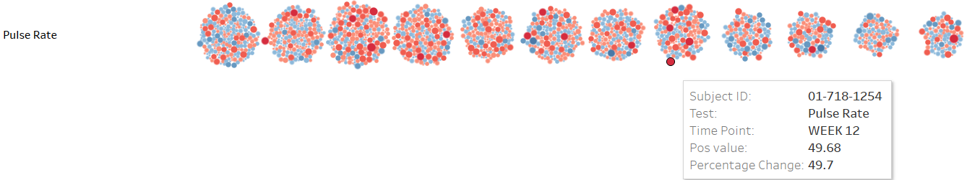
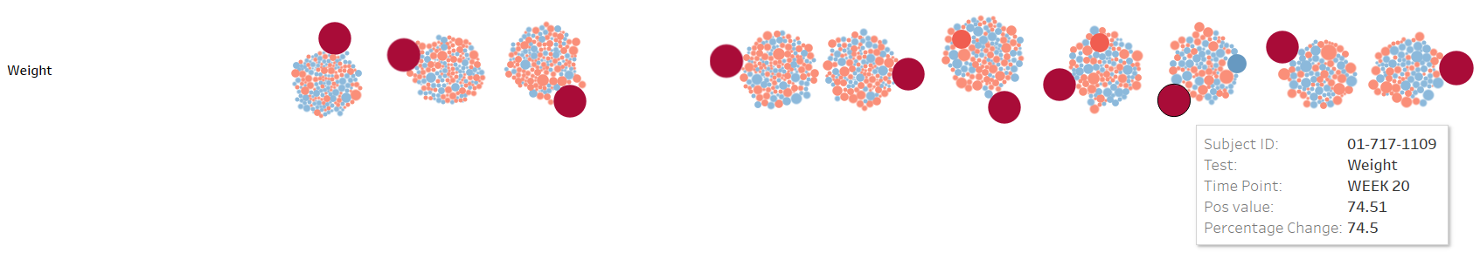
The number of subjects have reduced over time which can be due to lost to follow-up and the following changes have been observed:
Diastolic blood pressure, Systolic blood pressure, and pulse rate had increased (from baseline) in the earlier time points for quite a number of patients but by the end of 26 weeks, we can observe that a decrease is observed for most patients.
Temperature was stable for the participants across the time points. Weights of patients had slight changes but were mostly stable with one subject having an extreme increase in weight.

Slide 6
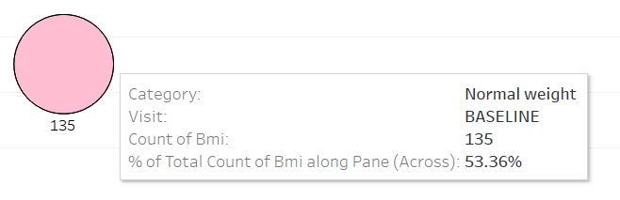
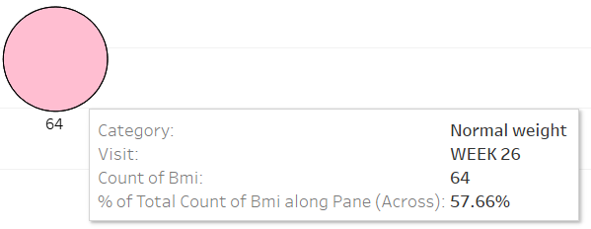
2ND Visualization-
The graph has in its horizontal axis, “Visits” which is split into “BMI Categories” i.e. (Overweight, Normal weight, Underweight) and the vertical axis which represent “Number of Subjects”.
The bubble size increases or decreases according to the number of subjects. The colour of the bubbles represents the three different categories.
The number of subjects have reduced over time and the following changes have been observed:
The proportion of normal weight subjects have increased from 53.36% to 57.66%.

Slide 7
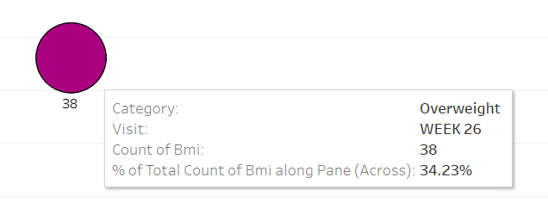
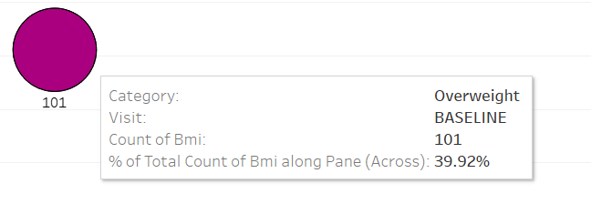
The proportion of overweight subjects have increased from 39.92% to 34.23 %.
3. The proportion of underweight subjects have increased from 6.71% to 8.10%.
If there were specific interventions or programs implemented during this time aimed at promoting healthy weight, the increase in the proportion of normal weight subjects suggests that the intervention had a positive impact.
Visualization | Variables | Type | Description
1 | Subject ID | String | Unique identifier for each subject
 | Test | String | Parameters measured
 | Time point | String | Time points of the measurements
 | Change | Float | Numerical change in the measurement compared to the baseline
 | Percentage change | Float | Percentage change in the measurement compared to the baseline
2 | Subject ID | String | Unique identifier for each subject
 | Visit | String | Time points of the measurements
 | BMI (kg/m²) | Float | Body Mass Index (BMI) of the subject at a particular visit
 | Category | String | Category that describes the BMI of the subject at a particular visit

